Slide 1


Azure Data Factory Capstone – Covid Use Case
BY MATHAN PRASATH R (2308187)
AIA-AZURE(INT2AIA23AZ001)
MENTOR – KAVIN KUMAR GOVINDARAJ
COACH – LAVANYA PALANI

Slide 2

PROBLEM STATEMENT
How to ingest data from flat files into Azure Data Lake Gen2 and Azure Synapse using Azure Data Factory (ADF) ​
How to transform data using Data Flows in Azure Data Factory (ADF) and load into Azure Synapse​

Slide 3
INTRODUCTION
CREATING RESOURCE GROUP
CREATING AZURE DATA LAKE STORAGE GEN2 ACCOUNT
CREATING AZURE DATA LAKE STORAGE GEN2 CONTAINER
CREATING AZURE DATA FACTORY
CREATING AZURE SYNAPSE WORKSPACE

Slide 4




REQUIREMENTS
RESOURCE
GROUPS
STORAGE
ACCOUNTS
AZURE
DATA FACTORY
AZURE
SYNAPSE STUDIO

Slide 5
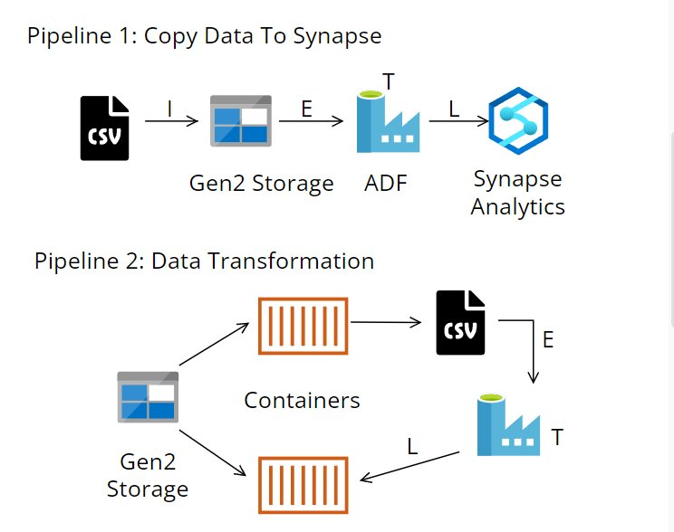
ARCHITECTURE DIAGRAM

Slide 6
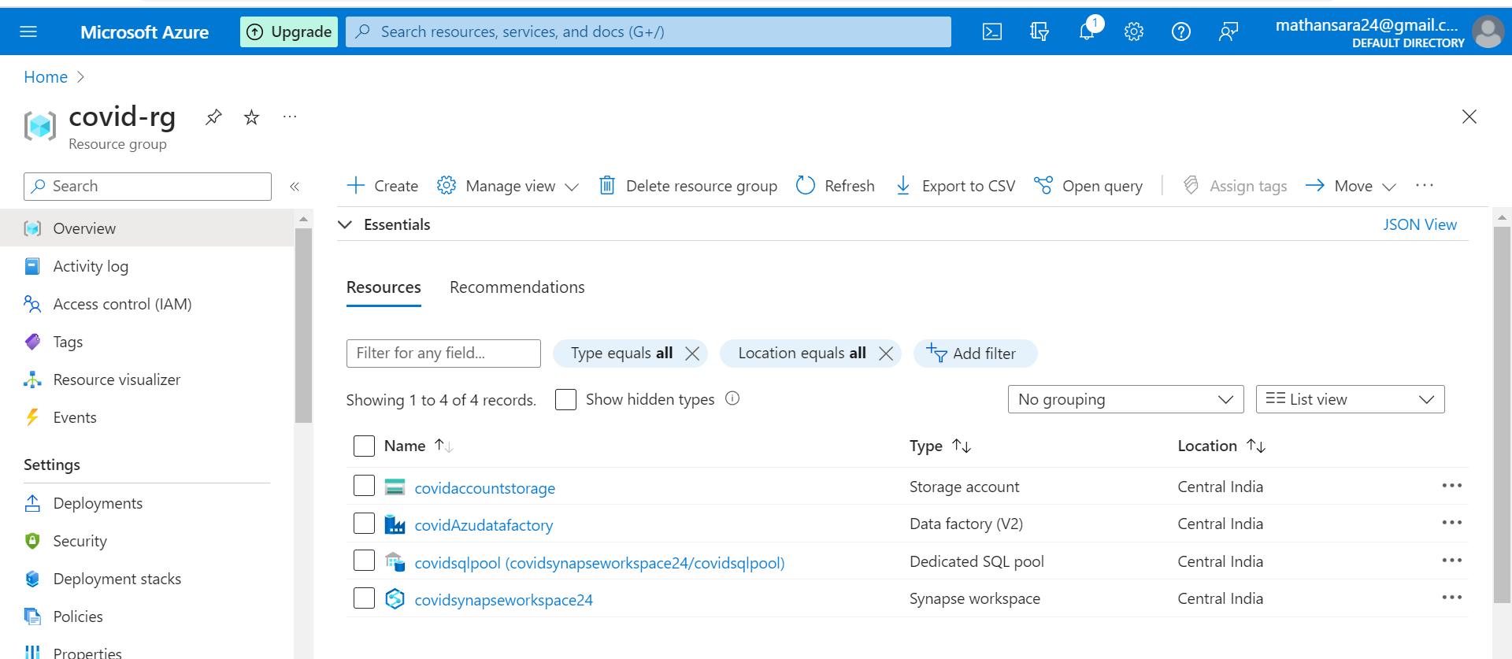
RESOURCE GROUP

Slide 7
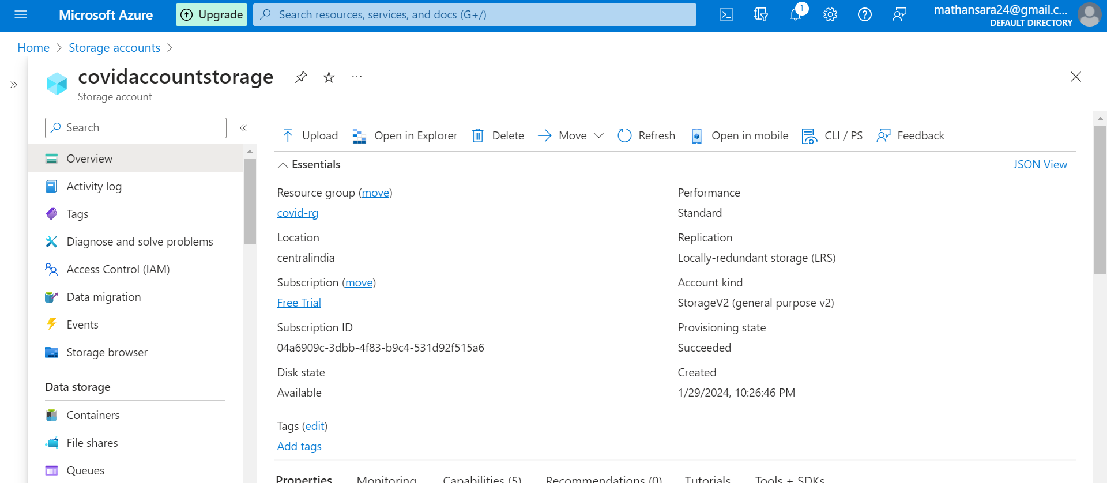
AZURE DATA LAKE STORAGE GEN2

Slide 8
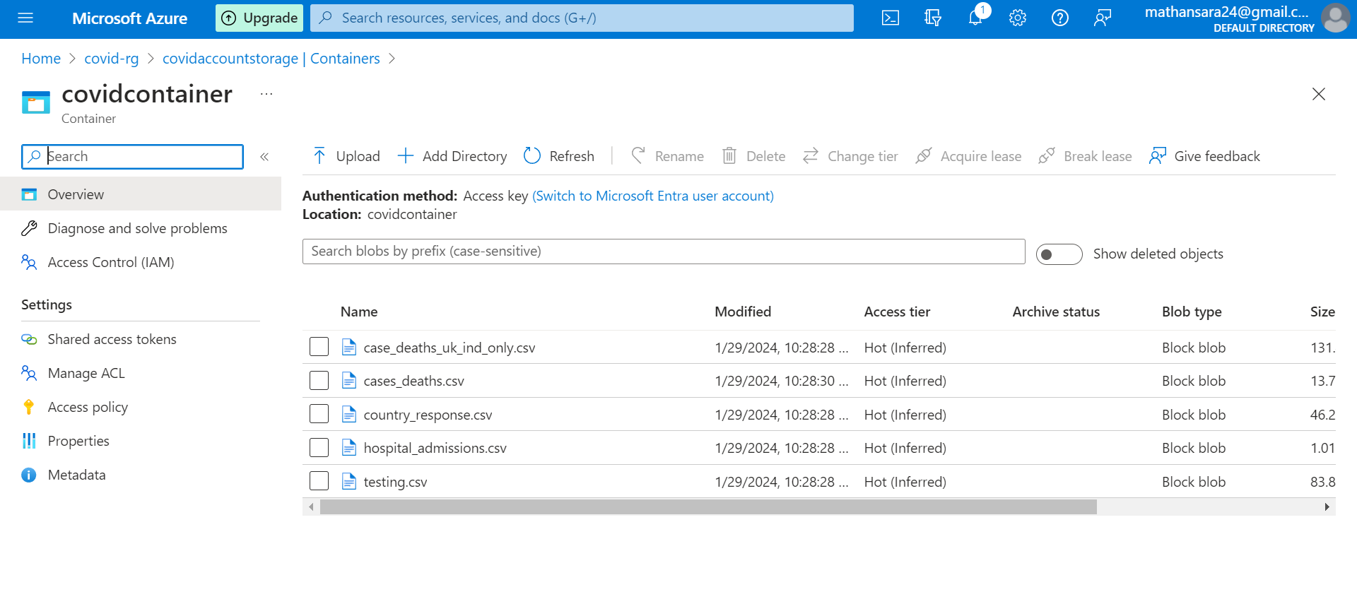
AZURE CONTAINER

Slide 9
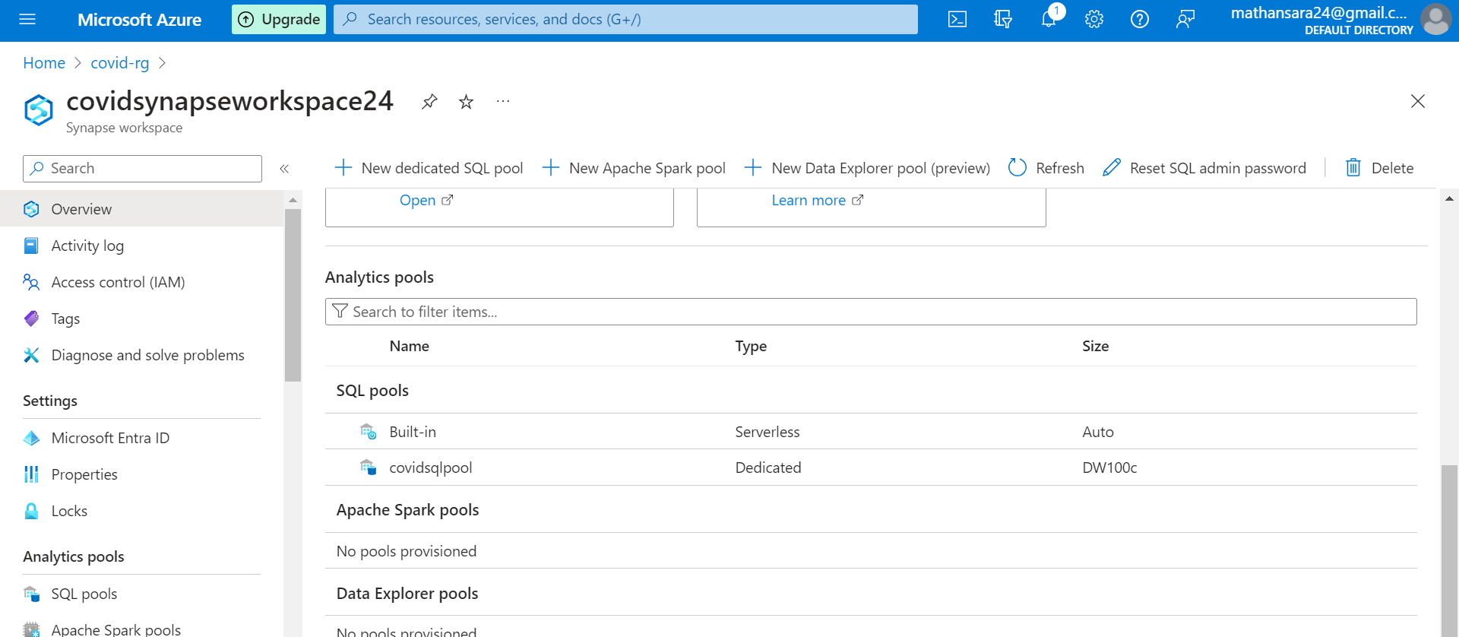
AZURE SYNAPSE WORKSPACE

Slide 10
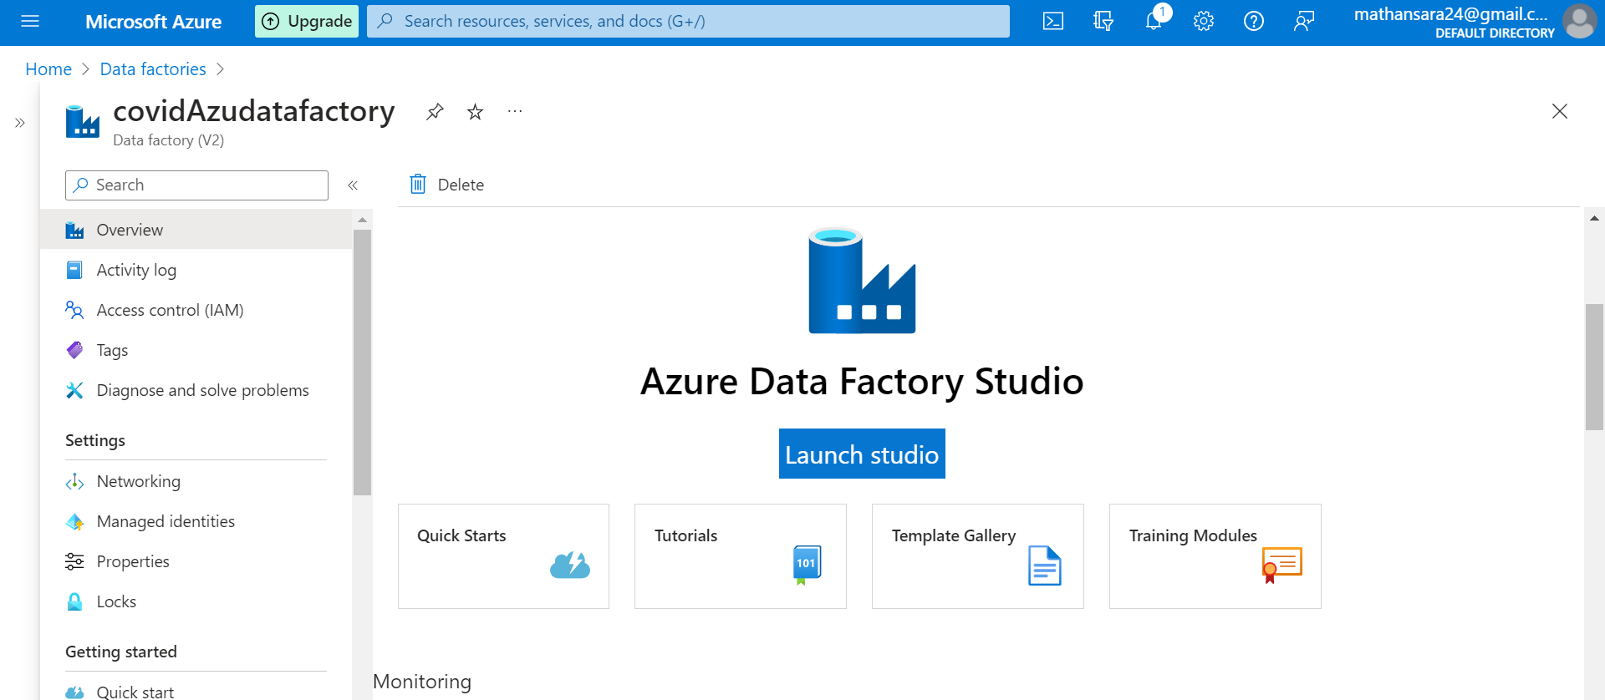
AZURE DATA FACTORY

Slide 11
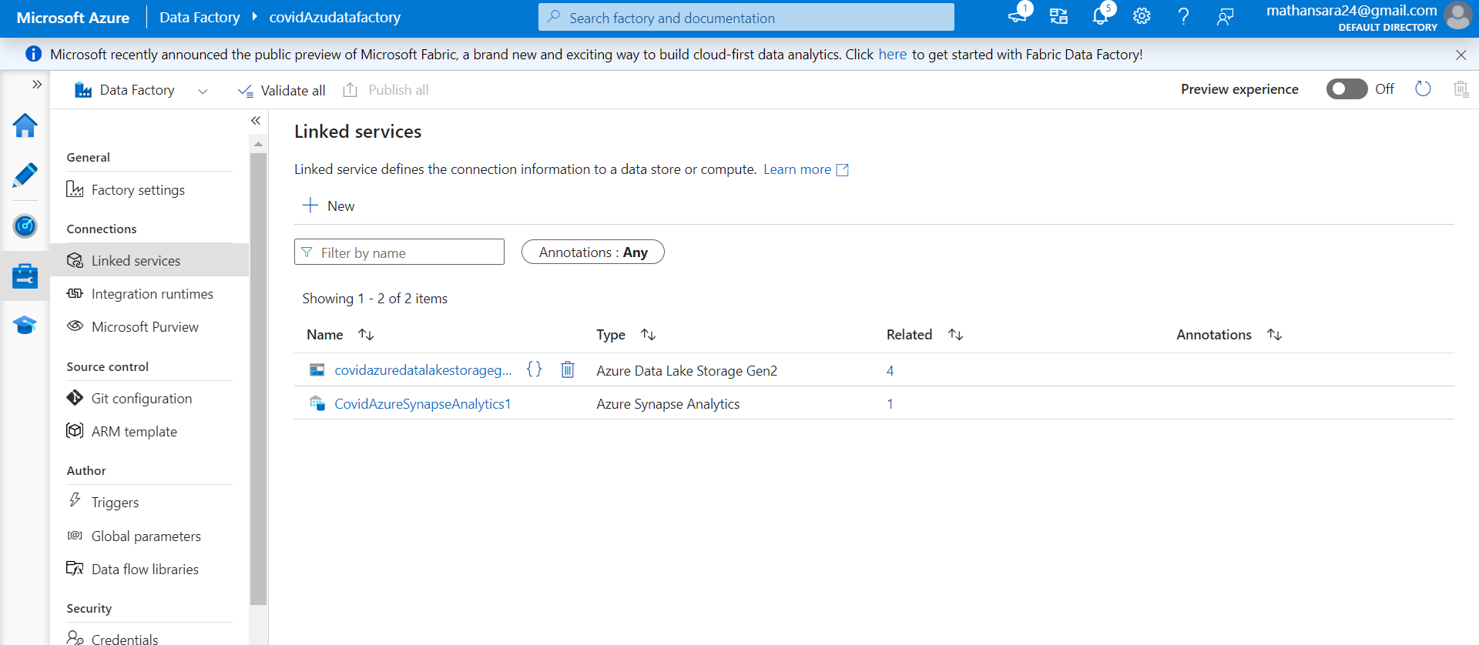
LINKED SERVICE FOR SOURCE AND SINK IN ADF

Slide 12
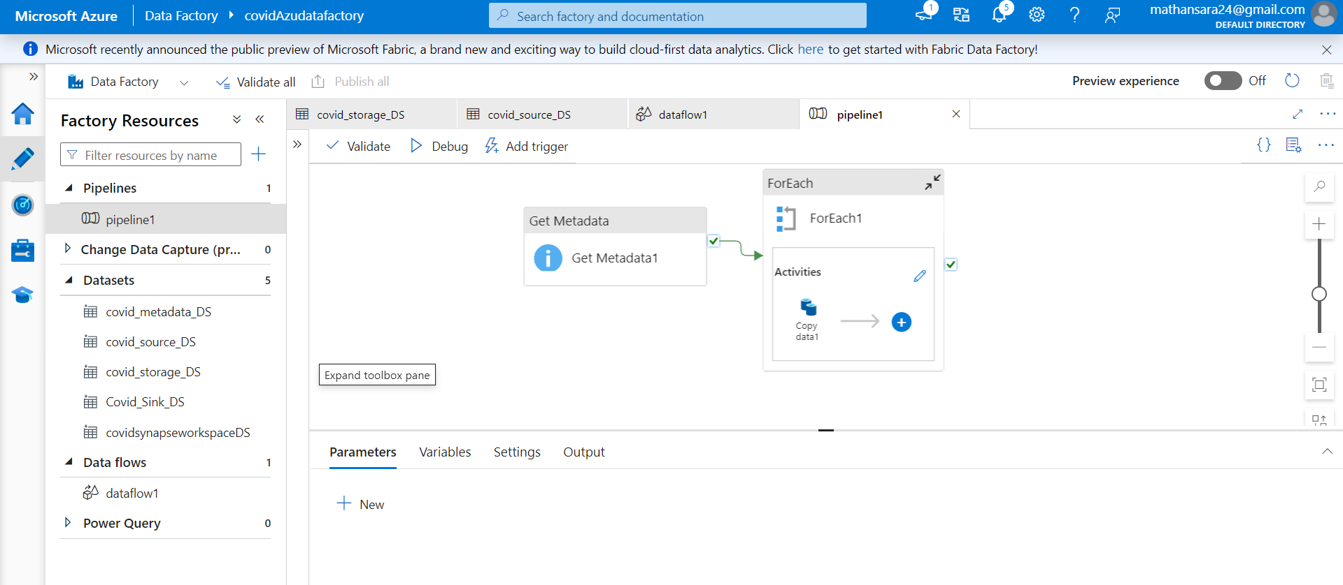
CREATED DATASETS

Slide 13
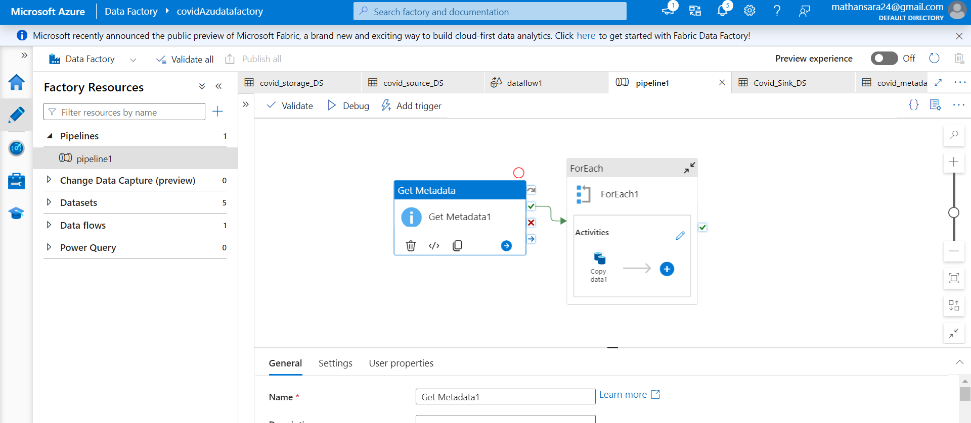
CREATED PIPELINE

Slide 14
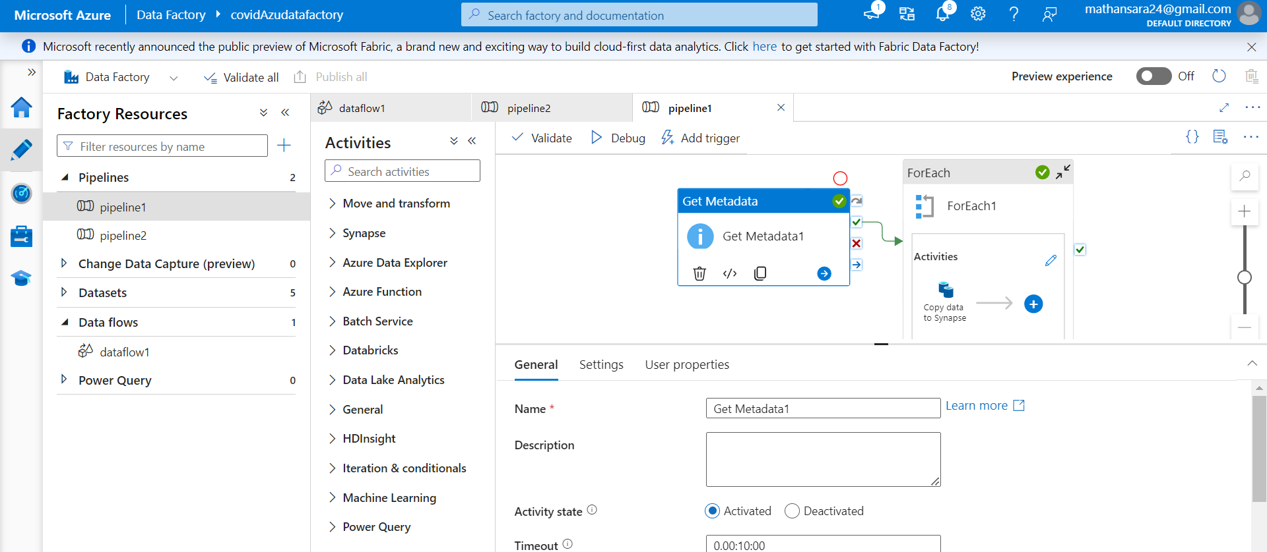
GET METADATA ACTIVITY

Slide 15
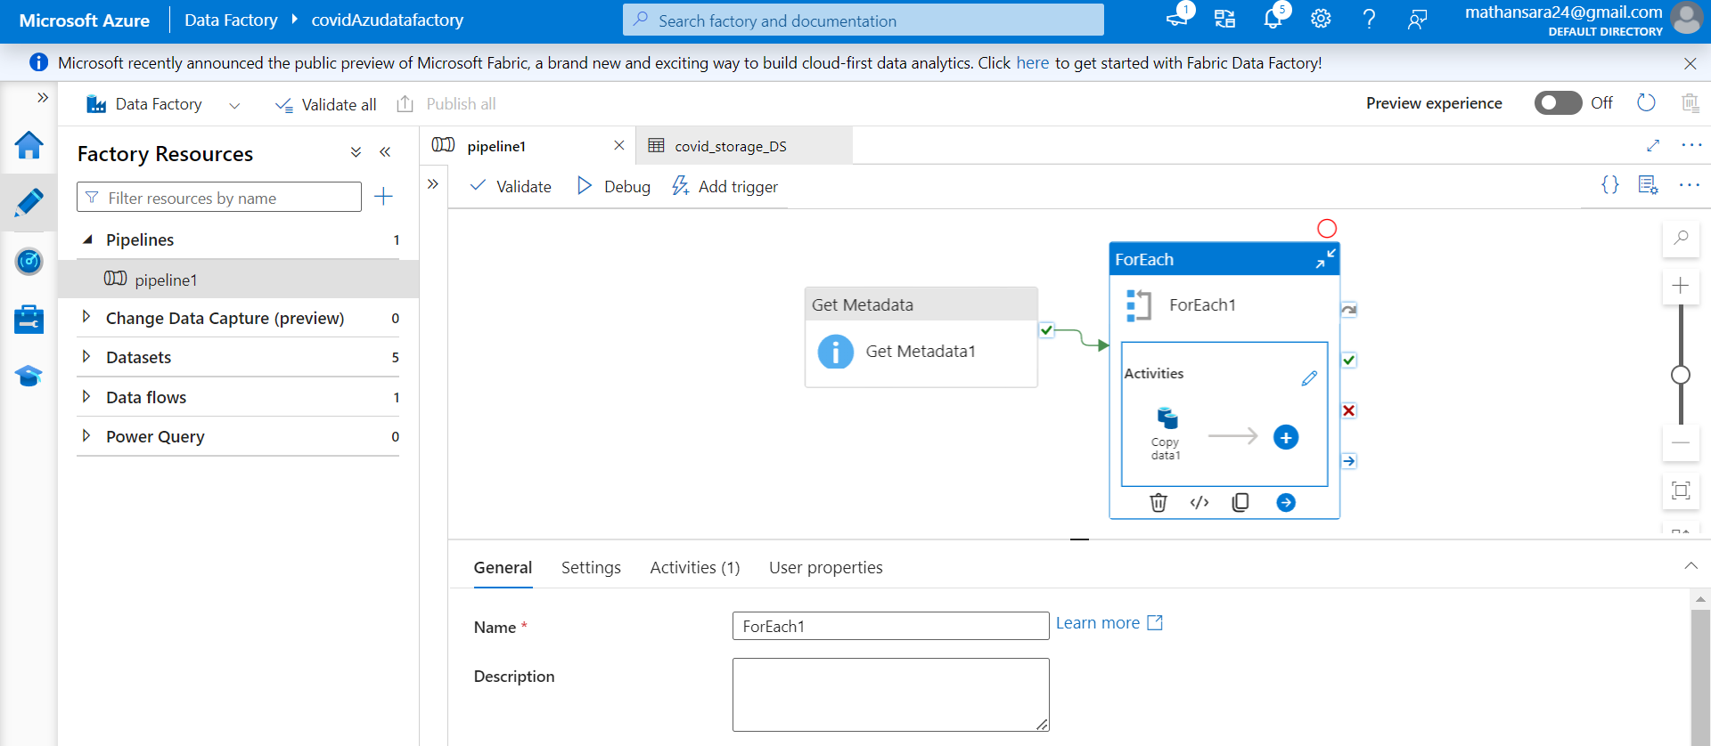
FOR EACH ACTIVITY

Slide 16
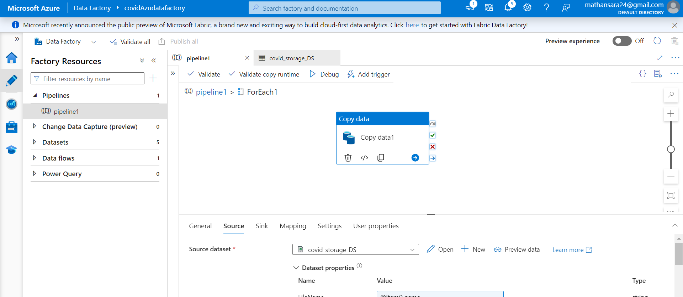
COPY DATA ACTIVITY

Slide 17
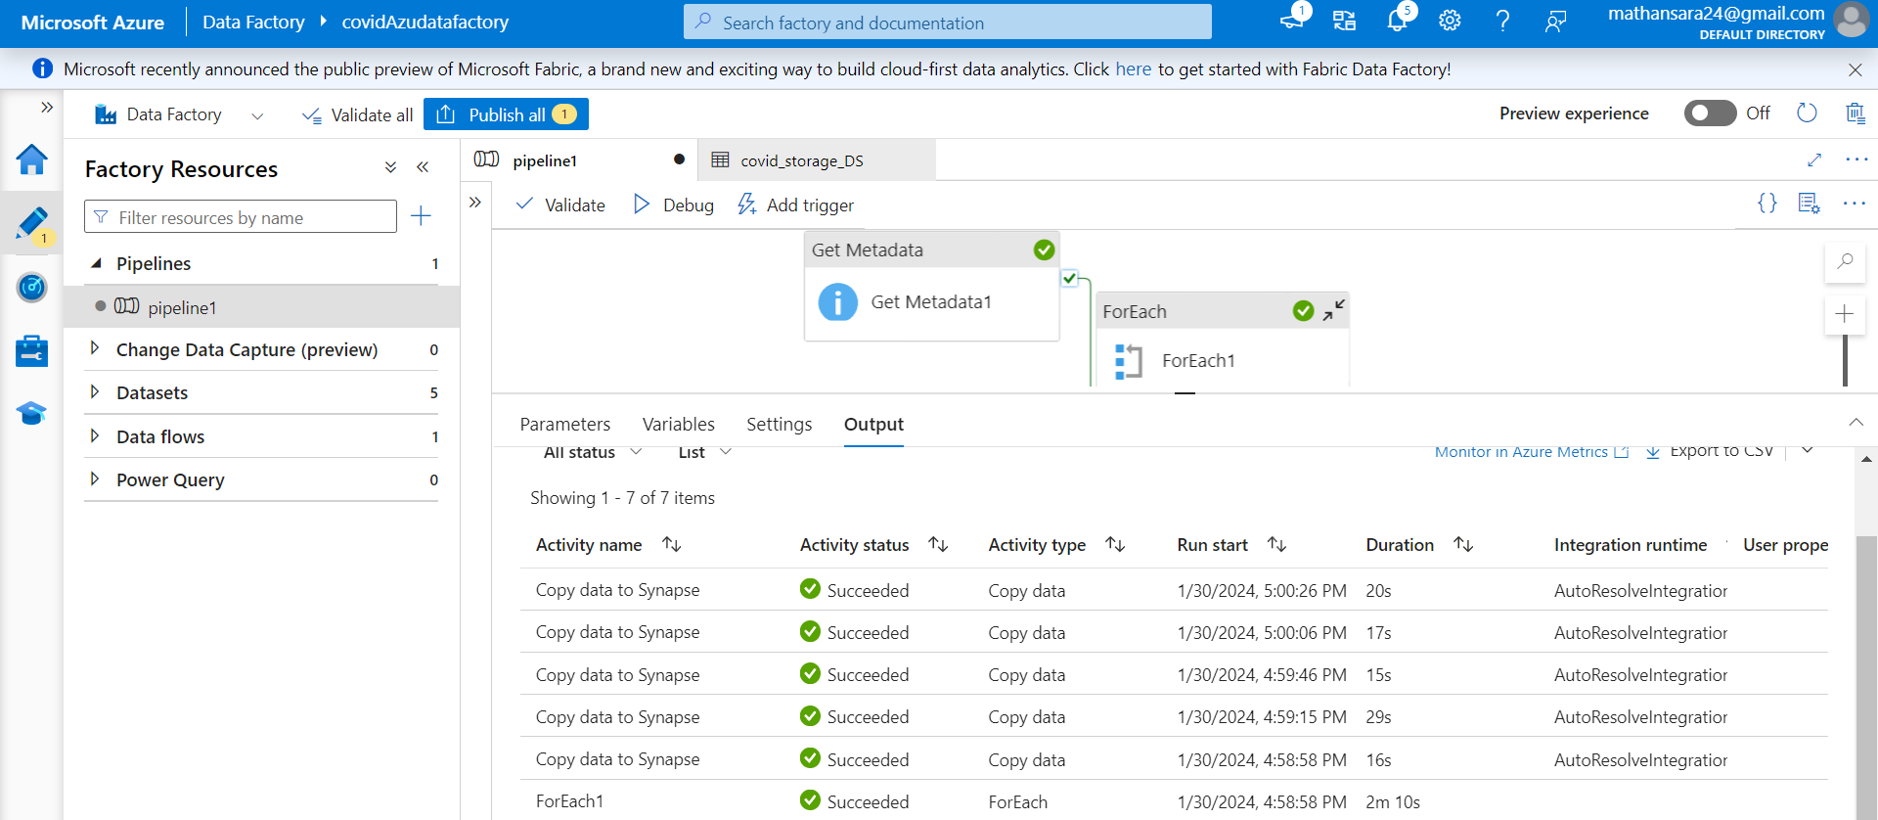
PIPELINE RESULTS

Slide 18
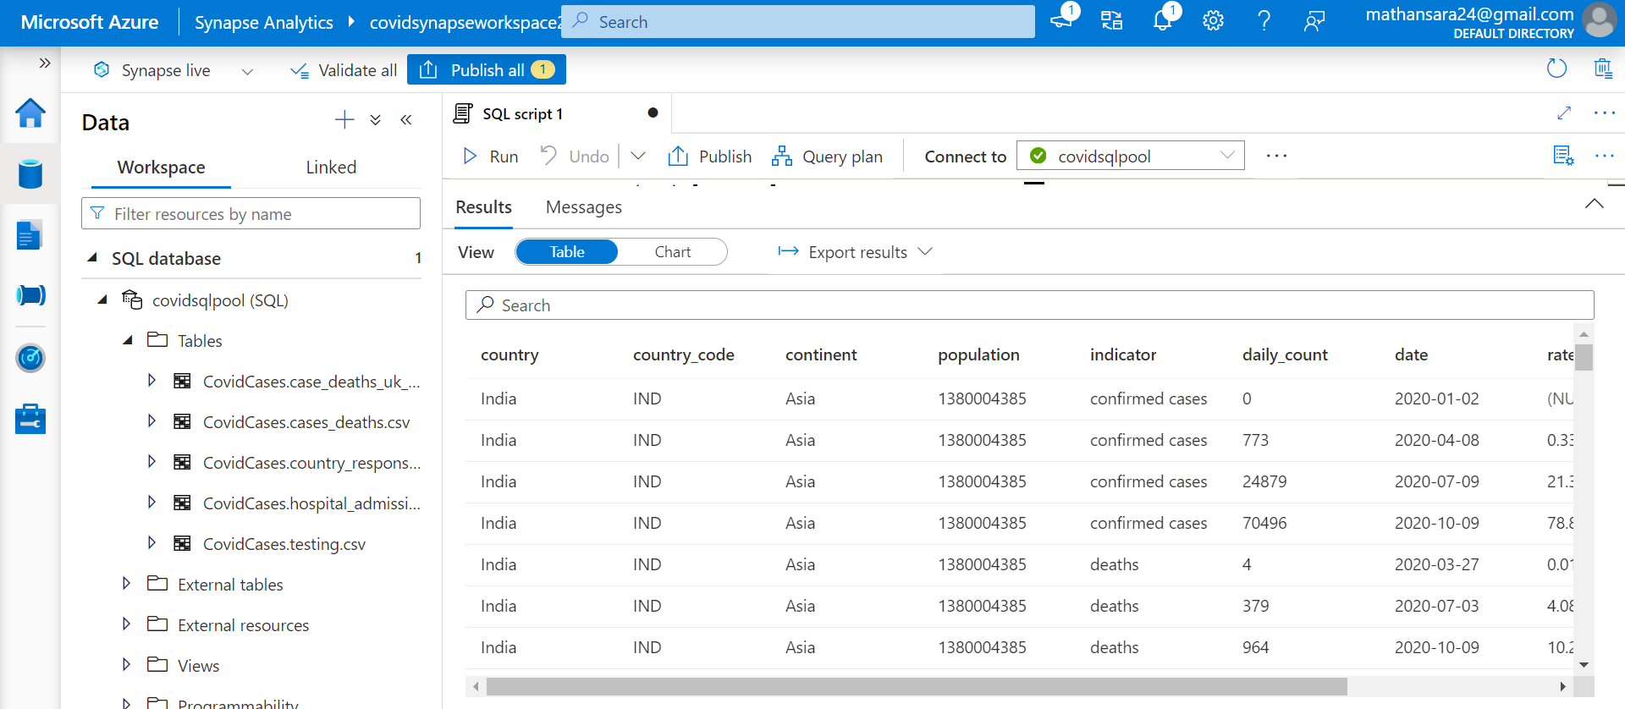
COPIED DATA TO SYNAPSE

Slide 19
SCHEMA OF THE TABLE’S
Dbo.DeathsInUKAndIndia
Dbo. AllOverDeaths
Column Technical Name | Column Datatype | Nullable? | PK? | FK? | Column Notes
Country | Varchar | Yes
CountryCode | Varchar | Yes
Continent | Varchar | Yes
Population | BigInt | Yes
Indicator | Varchar | Yes
DailyCount | BIgInt | Yes
Date | Date | Yes
Rate_14_Day | Decimal | Yes
Source | Varchar | Yes
Column Technical Name | Column Datatype | Nullable? | PK? | FK? | Column Notes
Country | Varchar | Yes
CountryCode | Varchar | Yes
Continent | Varchar | Yes
Population | BigInt | Yes
Indicator | Varchar | Yes
DailyCount | BIgInt | Yes
Date | Date | Yes
Rate_14_Day | Decimal | Yes
Source | Varchar | Yes
Dbo.CountryWiseResponseMeasure
Column Technical Name | Column Datatype | Nullable? | PK? | FK? | Column Notes
Country | Varchar | Yes
ResponseMeasure | Varchar | Yes
DateStart | Varchar | Yes
DateEnd | Varchar | Yes

Slide 20
SCHEMA OF THE TABLE’S
Dbo.HospitalAdmissions
Column Technical Name | Column Datatype | Nullable? | PK? | FK? | Column Notes
Country | Varchar | Yes
Indicator | Varchar | Yes
Date | Datetime | Yes
Year_Week | Varchar | Yes
Value | Decimal | Yes
Source | Varchar | Yes
URL | Varchar | Yes
Dbo.Testing
Column Technical Name | Column Datatype | Nullable? | PK? | FK? | Column Notes
Country | Varchar | Yes
CountryCode | Varchar | Yes
Year_Week | Varchar | Yes
New_Cases | BigInt | Yes
Tests_Done | BigInt | Yes
Population | BigInt | Yes
Testing_Rate | Decimal | Yes
Positivity_Rate | Decimal | Yes
Testing_Data_Source | Varchar | Yes

Slide 21
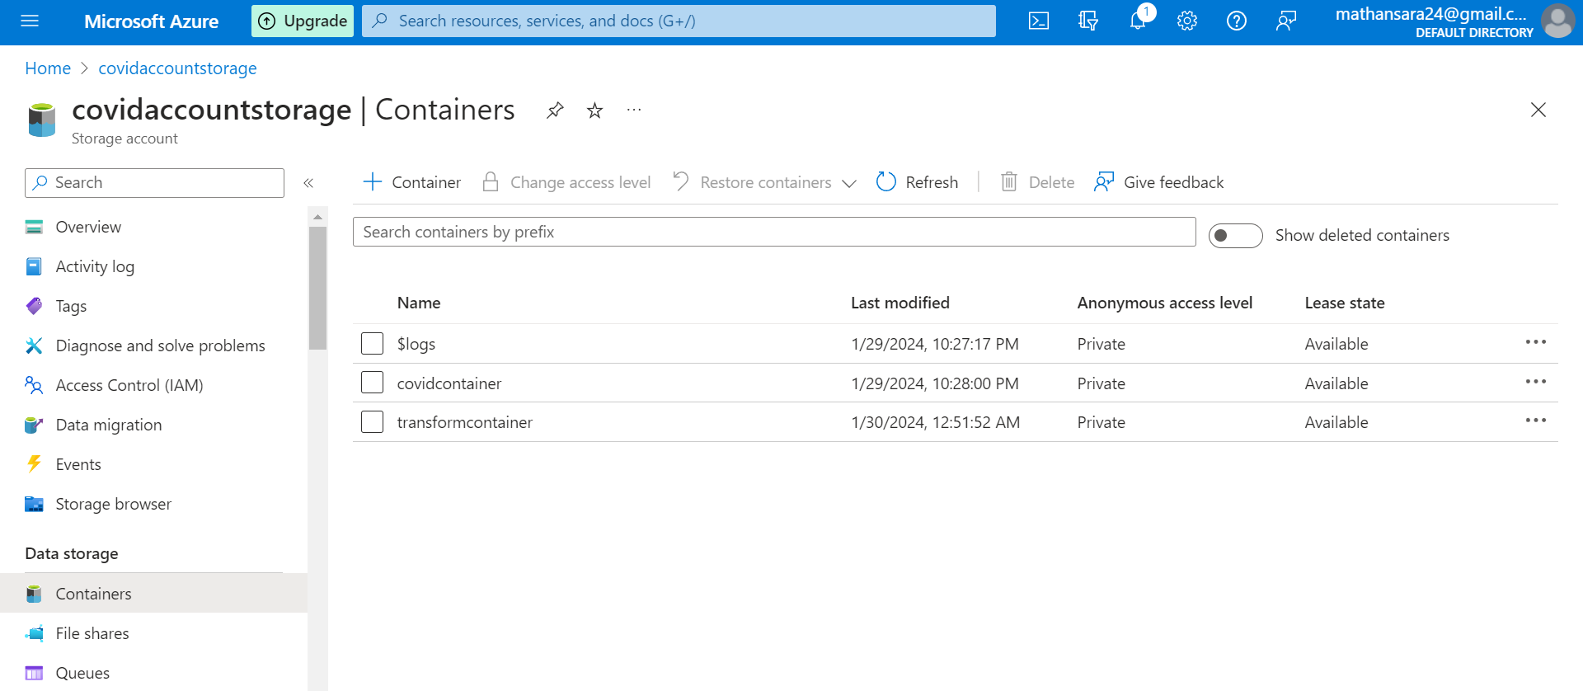
CREATED ANOTHER CONTAINER FOR STORING TRANSFORMED DATA IN GEN2

Slide 22
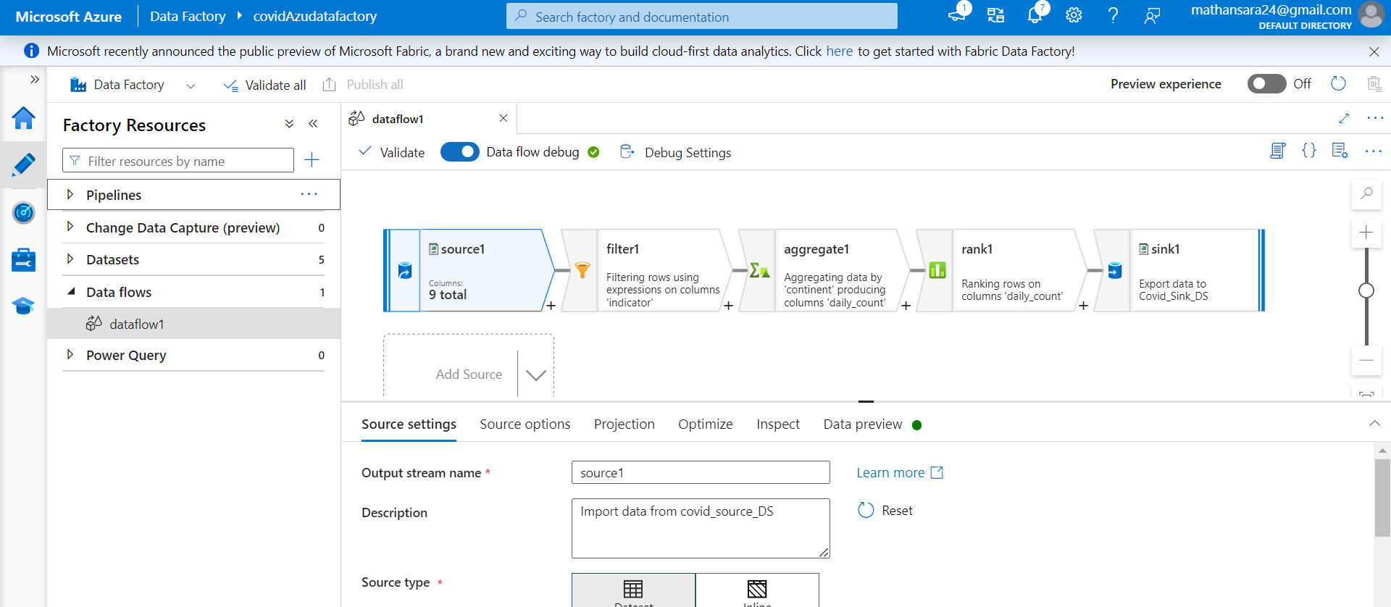
DATA FLOW – ADDING SOURCE

Slide 23
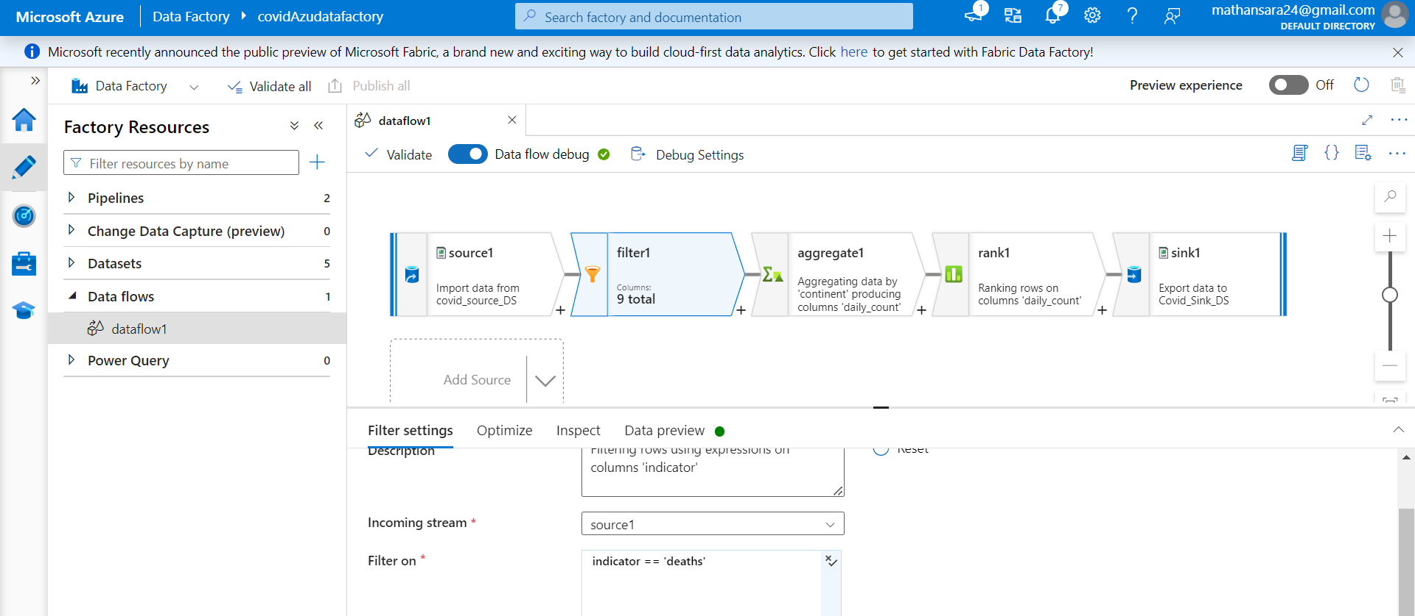
DATA FLOW – FILTER ACTIVITY

Slide 24
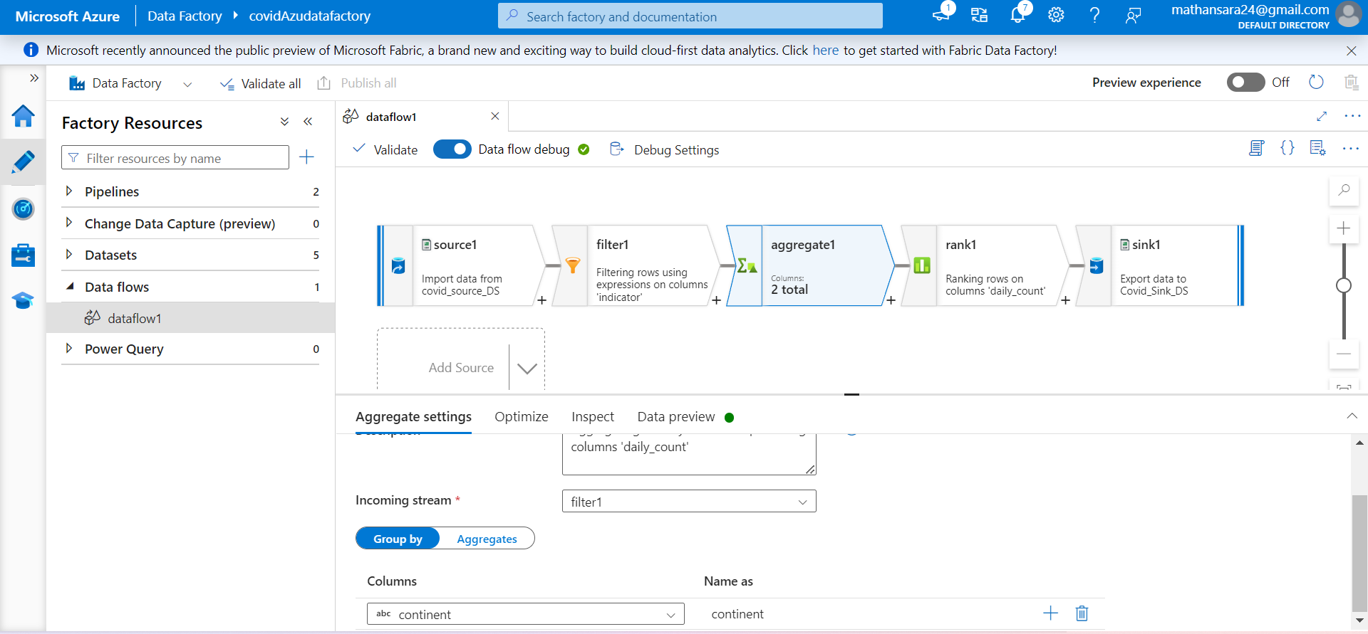
DATA FLOW – AGGREGATE

Slide 25
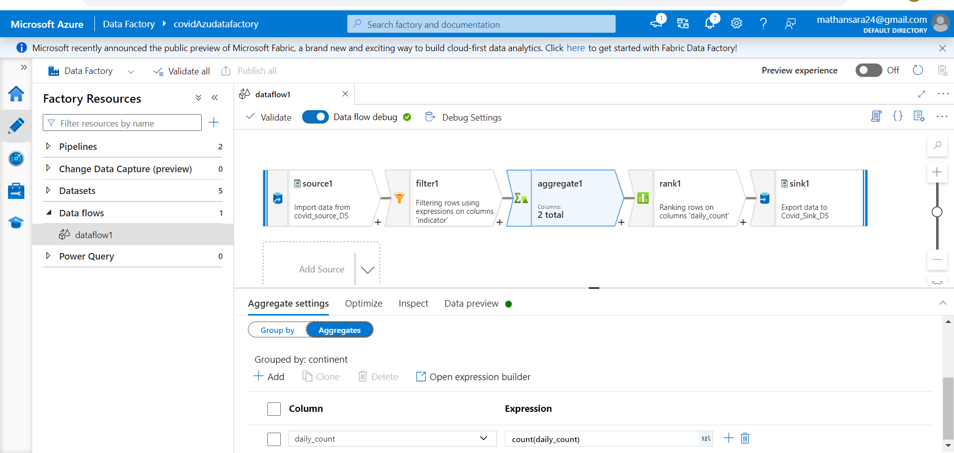
DATA FLOW – AGGREGATE

Slide 26
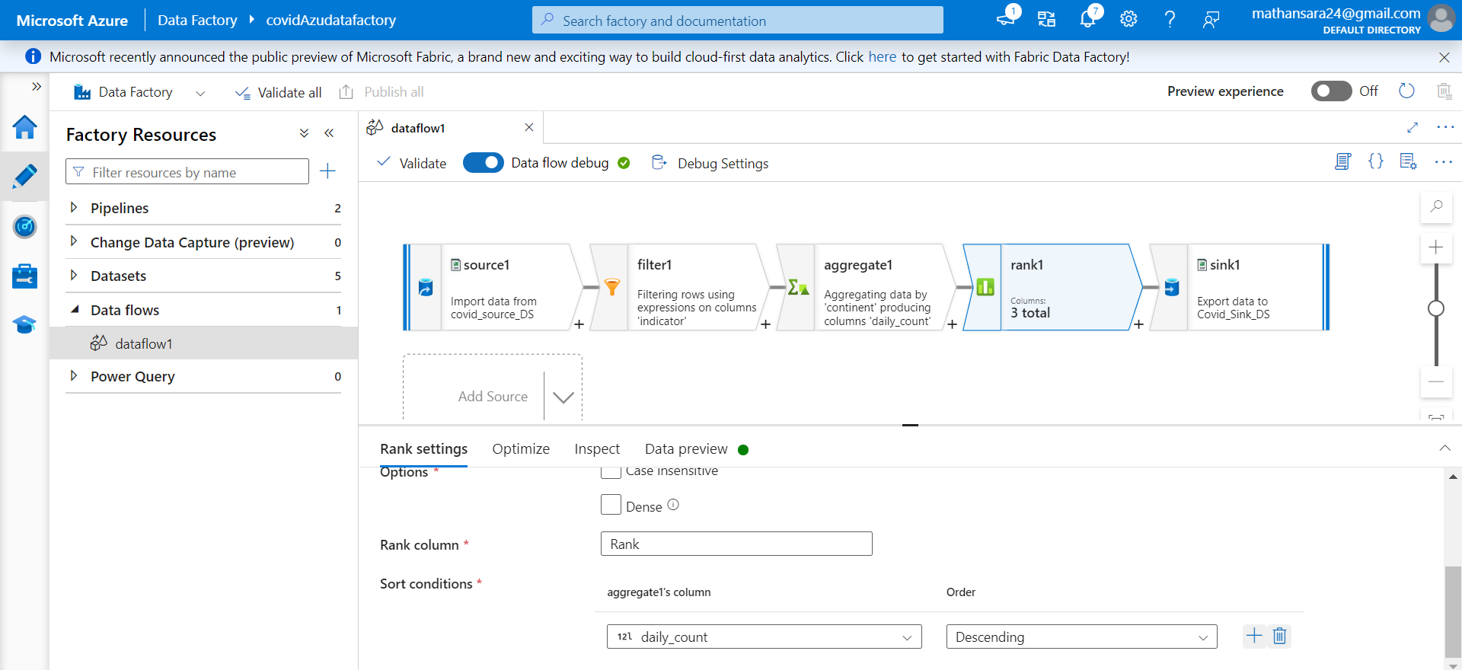
DATA FLOW – RANK

Slide 27
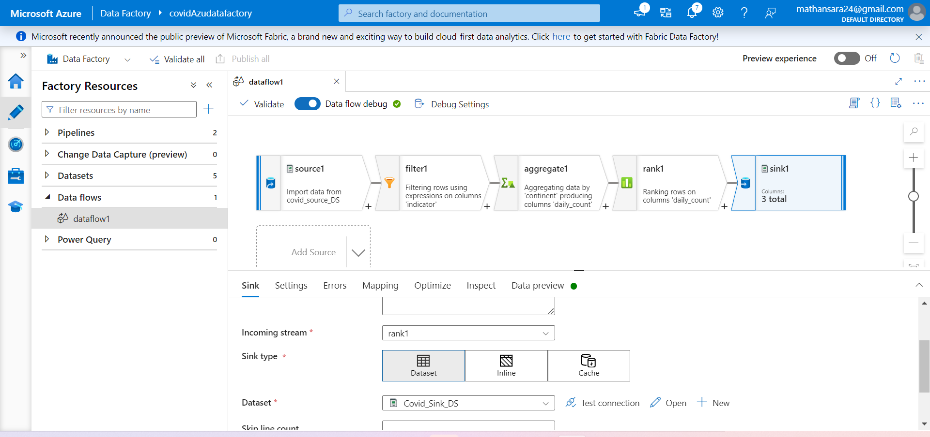
DATA FLOW – SINK

Slide 28
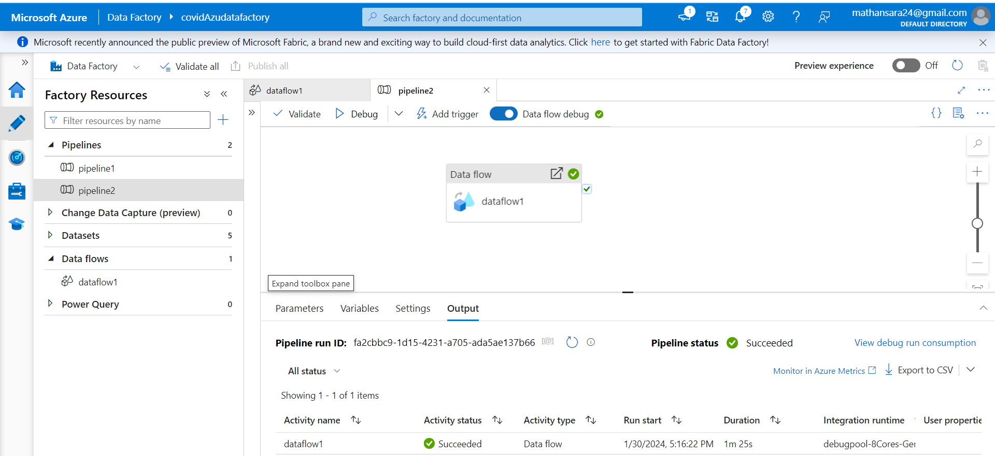
DATA FLOW PIPELINE

Slide 29
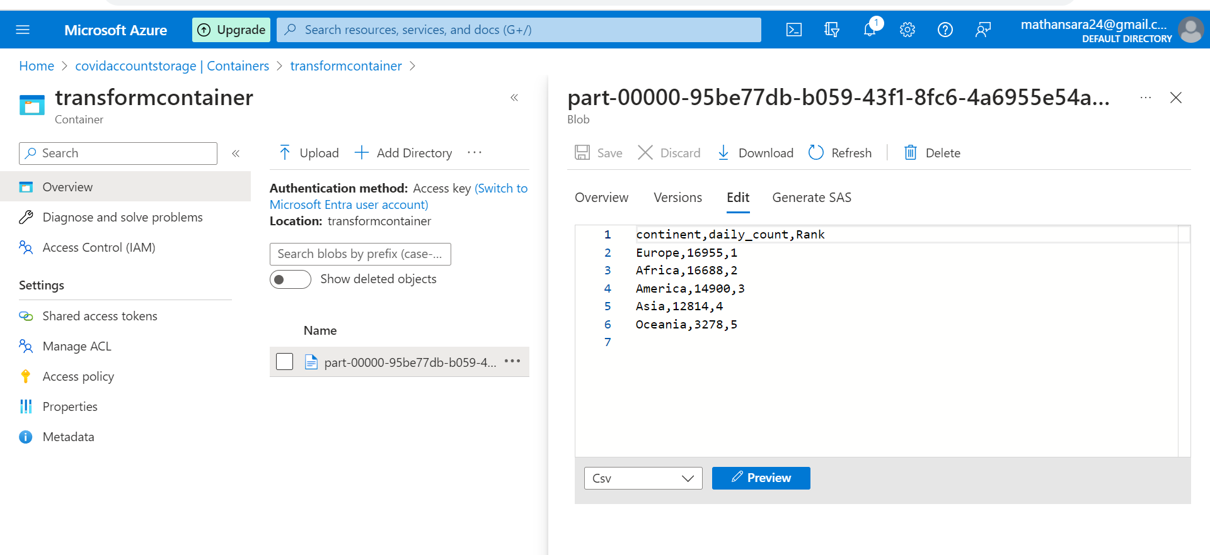
DATAFLOW TRANSFORMATION RESULT

Slide 30
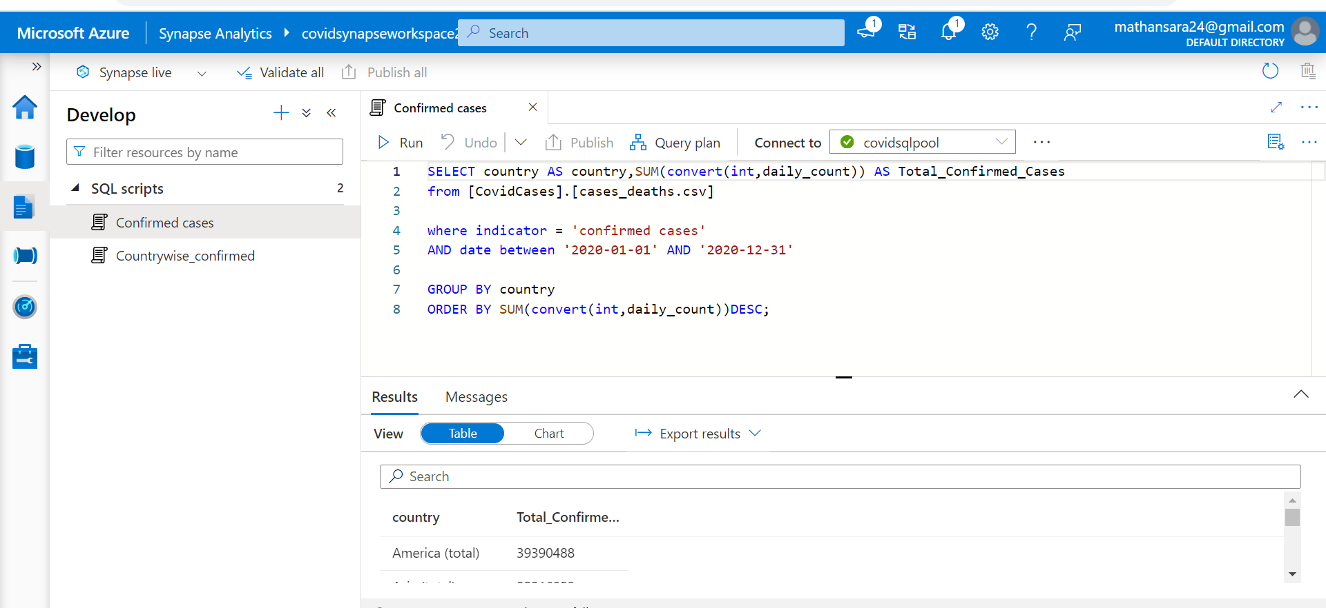
DATA VERIFICATION – QUERYING TO SHOW COUNTRY WISE CONFIRMED CASES IN 2020

Slide 31
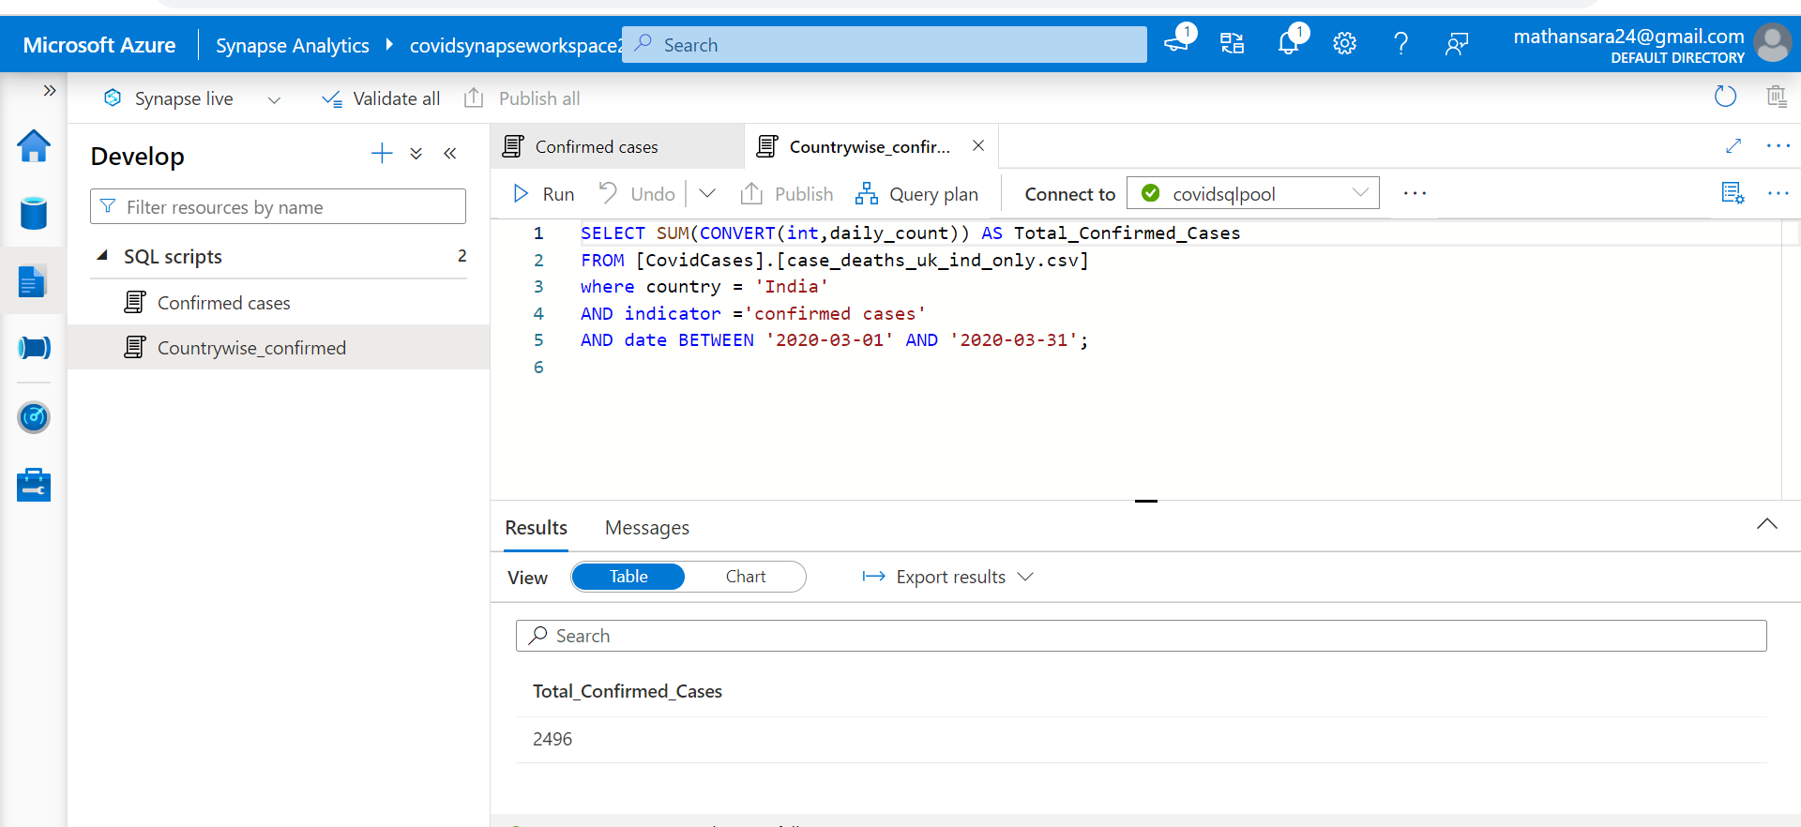
QUERYING FOR CONFIRMED CASES OF COVID IN INDIA IN SYNAPSE

Slide 32

SUMMARY
Resources have been successfully created and data has been loaded into Synapse for analysis on Azure.

